Slide 1
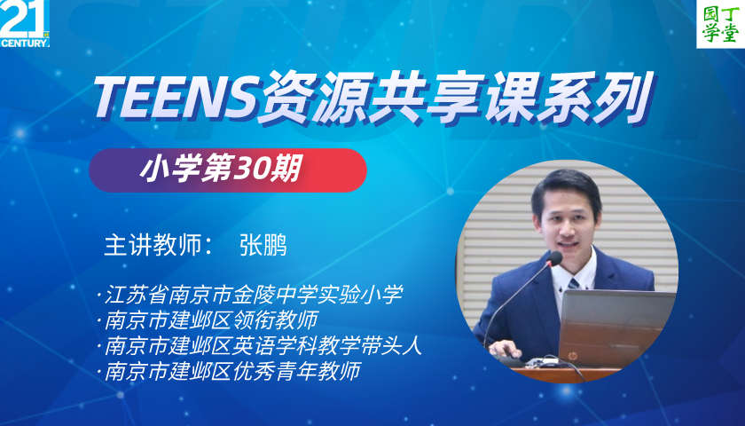

Slide 2
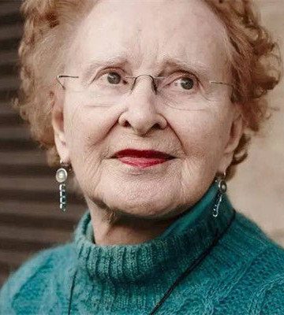

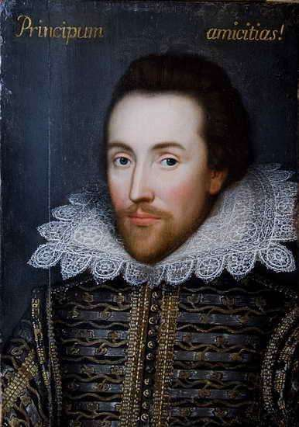
Be a good reader
Keep reading!
“I love reading, so naturally I like to write.”
------Beverly Cleary
我爱读书，自然我也爱写作。
------贝芙莉·克莱瑞
Make writing fun!
“He has never fed of the dainties that are bred in a book；he has not eaten paper，as it were；he has not drunk ink；his intellect is not replenished；he is only an animal，only sensible in the duller parts．” ----Shakespeare
他不曾饱餐过书本中的美味；他没有吃过纸张，喝过墨水；他的智力是残缺破碎的；他不过是一头畜生，只有下等的感觉。 ------莎士比亚

Slide 3
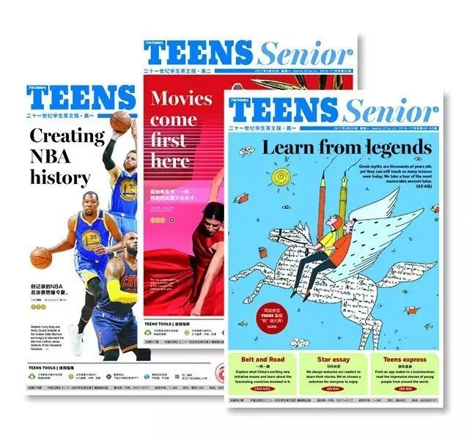
Newspapers can give us the newest information.
新闻可以告诉我们最新的信息。

Slide 4


Let’s guess
What are we going to read today?

Slide 5
Let’s guess
What are we going to read today?

Slide 6
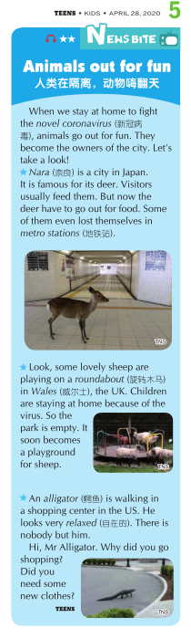
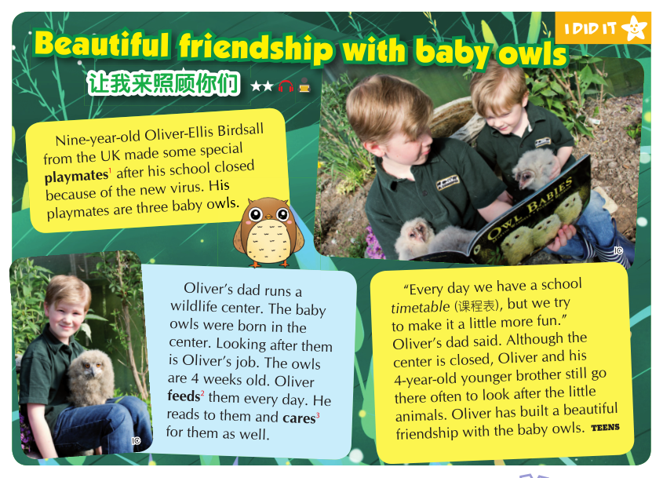
Two articles about animals

Slide 7
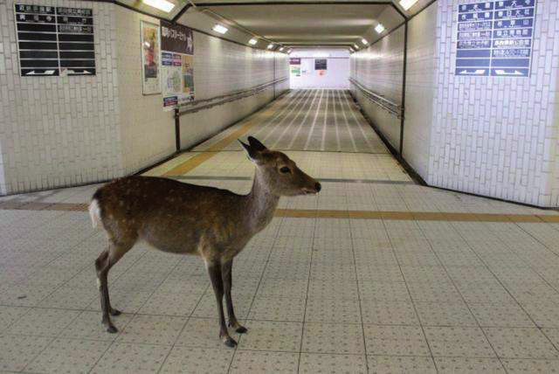
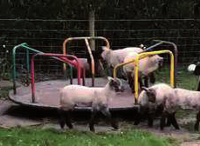
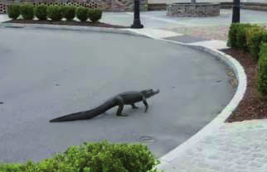
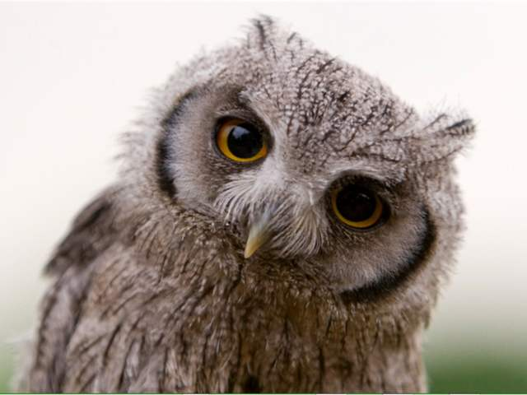
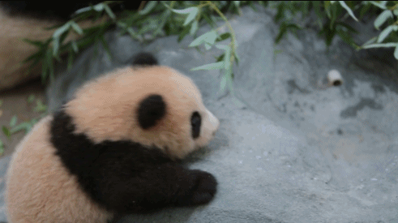
What animals do you know?
What animals do you like?

Slide 8
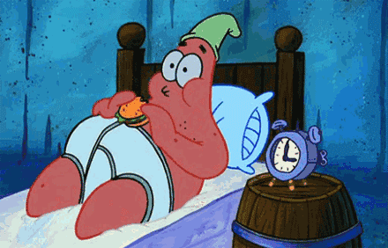


Because of the special virus,we have to：
1.Stay at home
2.Study online
3.Stay away from others
……

Slide 9
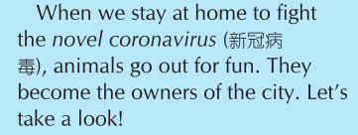

Let’s guess
What about the animals?
抗击
主人
What animals are mentioned（提及）?

Slide 10
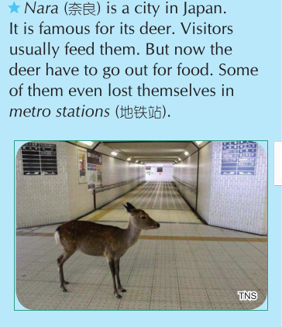
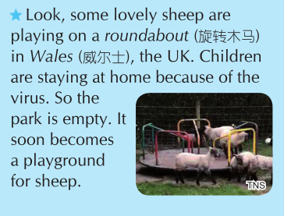
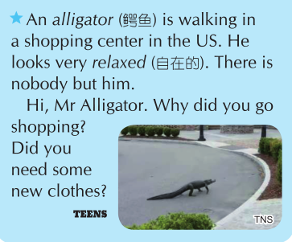
Let’s learn
sheep
alligator
deer

Slide 11
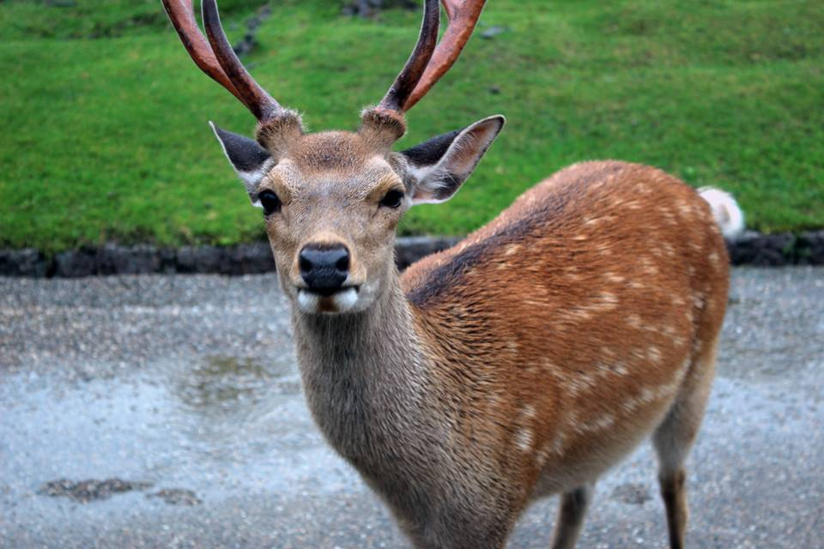
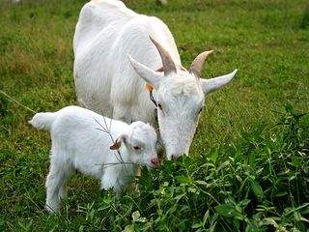
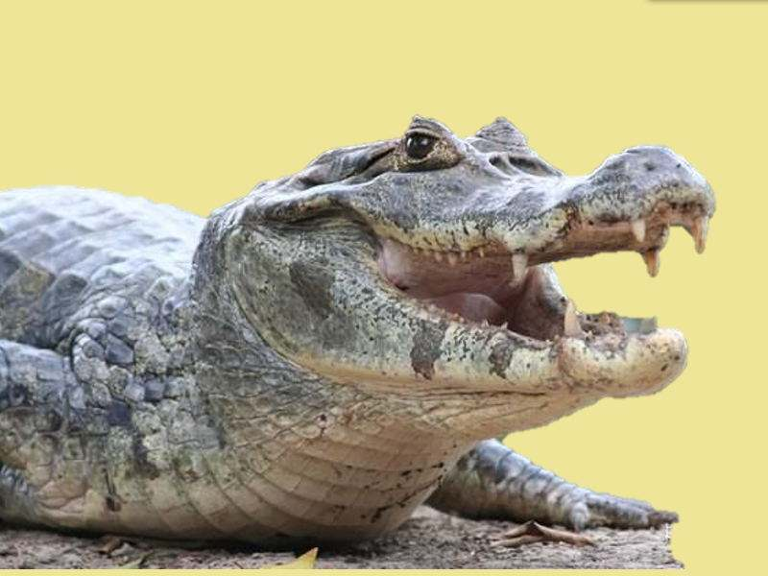
Let’s match
Animal（s） Where Activity（活动）
play on a roundabout
（旋转木马）
walking
lost themselves in metro station
（地铁站）
Wales（威尔士）
a shopping centre
Nara（奈良）

Slide 12
Let’s read

Slide 13
Let’s match
Animal（s） Where Activity（活动）
play on a roundabout
（旋转木马）
walking
lost themselves in metro station
（地铁站）
Wales（威尔士）
a shopping centre
Nara（奈良）
迷路

Slide 14
Let’s conclude
Animals out for fun
人类在隔离，动物嗨翻天
Find a title（标题）for this article

Slide 15
Two articles about animals

Slide 16
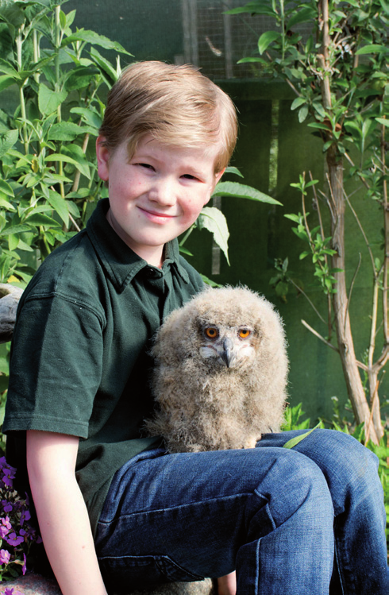
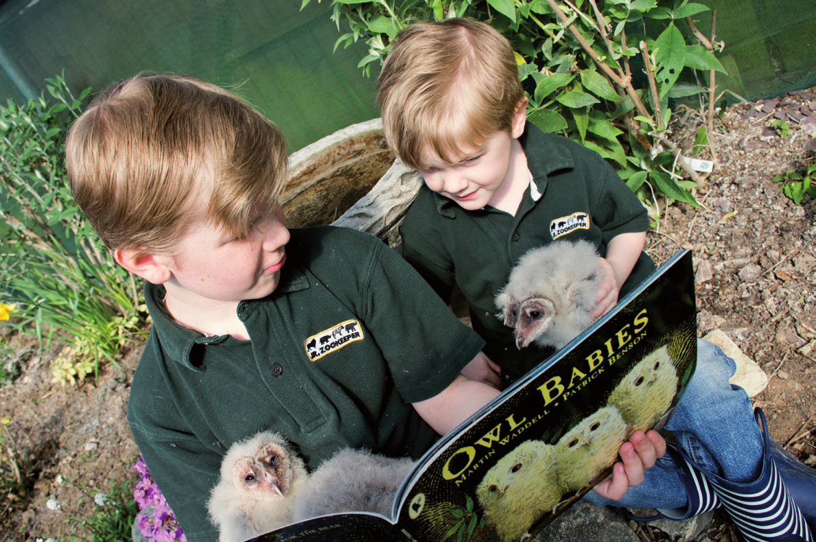
Oliver Ellis and the baby owl(s)
playmates 玩伴

Slide 17
Let’s learn
What do you know about Oliver Ellis's playmates(s)？
how many
how old
where
center
中心

Slide 18
Let’s check
Oliver Ellis is a nice boy.He has friends.
They are baby .The owls are born in Oliver's Dad's wildlife .Now they are four old.Every day，Oliver to them,looks them and feed(喂养)them.
What a boy Oliver is!
three
owls
center
weeks
reads
after
nice/kind…

Slide 19
What do you think of Oliver Ellis？
Oliver Ellis is because he the owls.
Can we help the animals？

Slide 20
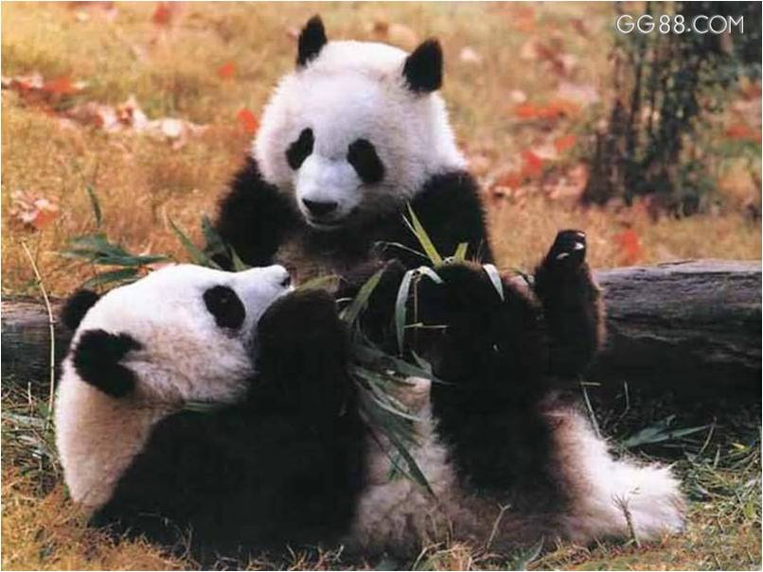
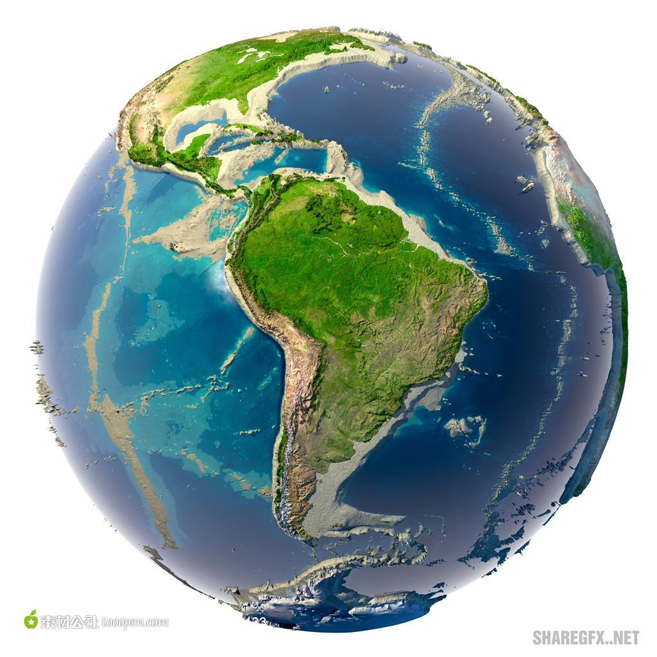

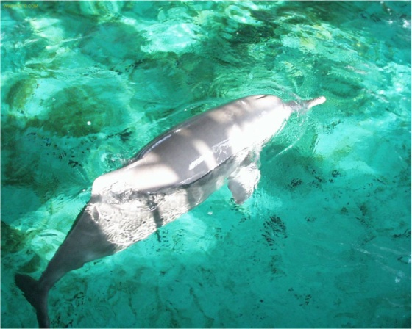
We live with animals on Earth.
人类与动物共存于地球。

Slide 21
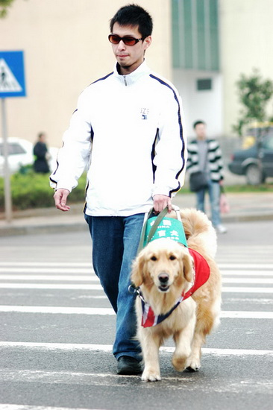
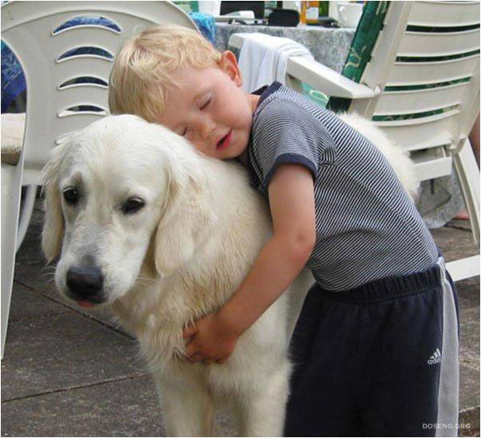
Animals help us a lot.
动物是人类的好帮手。

Slide 22
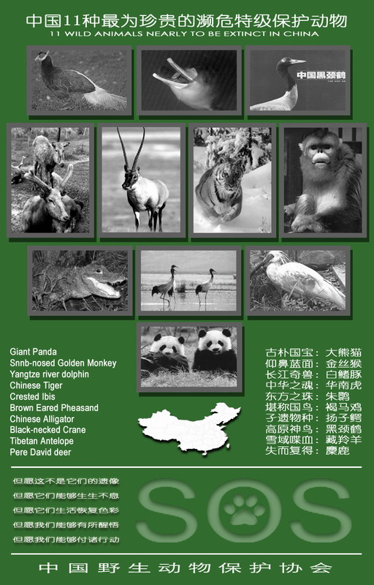

Slide 23

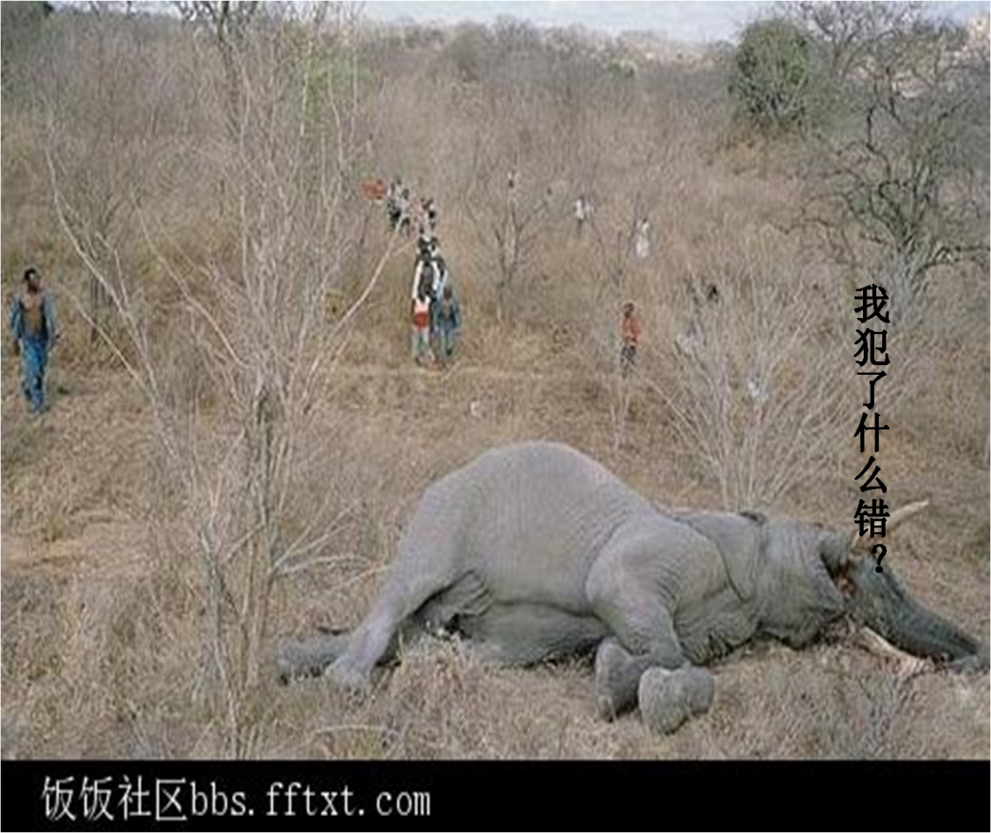
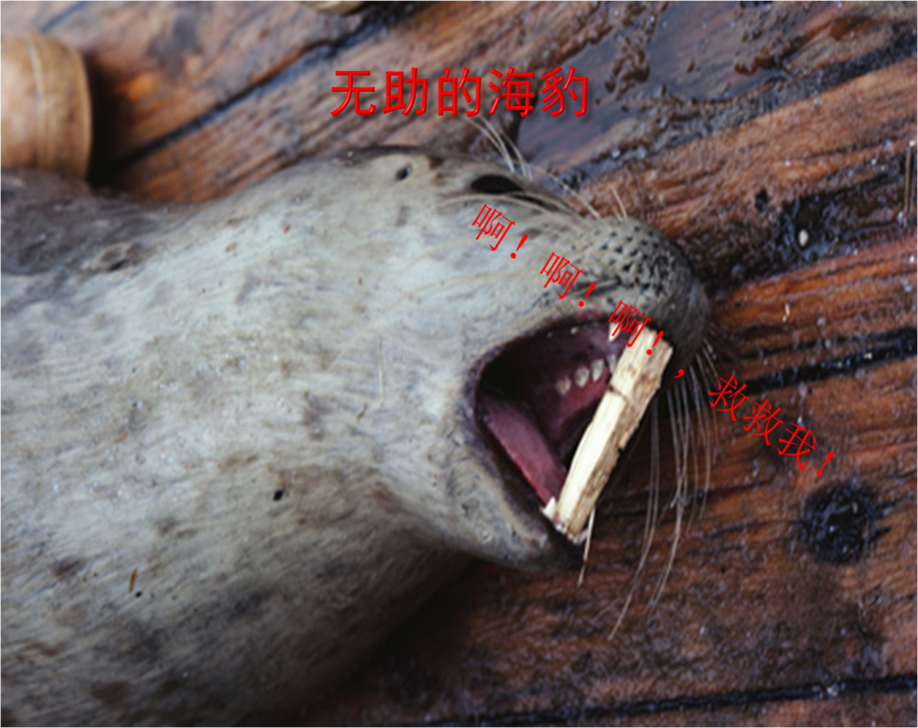
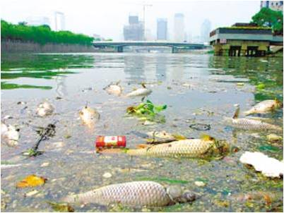

Slide 24
每年的10月4日为 “世界动物日”。
Animals are our friends.
动物是我们的朋友。
We should love animals.
我们应该关爱它们。

Slide 25

家庭作业
Homework
1. Read the newspapers.
2. Try to retell the stories.
2. Share the stories with more people.

Slide 26

Goodbye!

