Slide 1
2019-2020学年度第34期总第788期
Nature’s recovery
辽宁省 抚顺一中 姚成飞

Slide 2
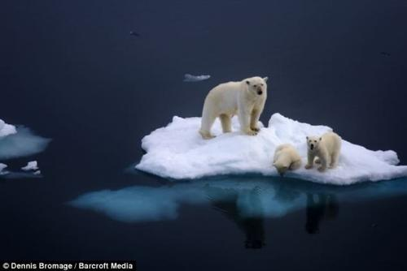
Lead-in
Questions before reading
No 1. What can we conclude from the first paragraph?
No 2. Why was Antarctica likely a rainforest 90 million years ago, according to the text?
No 3. What is the author’s purpose in writing the article?

Slide 3
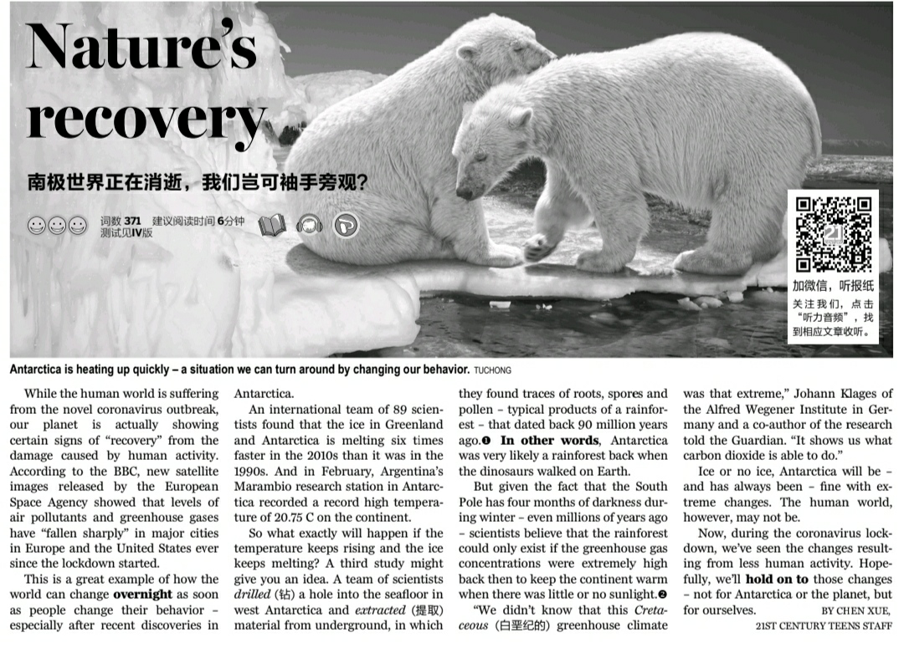
Reading

Slide 4
questions
1. What can we conclude from the first paragraph?
A. Major cities are to blame for most of the air pollution.
B. Reduced human activity has been good for the environment.
C. The novel coronavirus outbreak resulted from human activity.
D. The novel coronavirus outbreak has warned humans to protect nature.
While the human world is suffering from the novel coronavirus outbreak, our planet is actually showing certain signs of “recovery” from the damage caused by human activity. According to the BBC, new satellite images released by the European Space Agency showed that levels of air pollutants and greenhouse gases have “fallen sharply” in major cities in Europe and the United States ever since the lockdown started.

Slide 5
questions
2. Why was Antarctica likely a rainforest 90 million years ago, according to the text?
A. Its Cretaceous greenhouse climate was found to be unextreme.
B. Proof of high greenhouse gas concentrations were discovered there.
C. Typical products of a rainforest were found underground.
D. Traces of dinosaurs living in rainforests were found underground.
….. A team of scientists drilled (钻) a hole into the seafloor in west Antarctica and extracted (提取) material from underground, in which they found traces of roots, spores and pollen – typical products of a rainforest – that dated back 90 million years ago. In other words, Antarctica was very likely a rainforest back when the dinosaurs walked on Earth.

Slide 6
Questions
3. Which of the following would the author probably agree with?
A. Human activity doesn’t pose much of a threat to Antarctica.
B. Little can be done to stop extreme change in Antarctica.
C. The lockdown can be used to slow down global warming.
D. We should reduce carbon dioxide emissions for our own sake.
Ice or no ice, Antarctica will be – and has always been – fine with extreme changes. The human world, however, may not be.
Now, during the coronavirus lockdown, we’ve seen the changes resulting from less human activity. Hopefully, we’ll hold on to those changes – not for Antarctica or the planet, but for ourselves.

Slide 7
Word learning
Let go
To allow sth to be shown or bought publicly
To let sb or sth to come out of a location
1.Release [ri'li:s]
1) 别松开绳子。
________________________________________________
Don’t release the rope.
2) 污染物质正在不断地被排放到大气中去。
________________________________________________
Pollutants are constantly being released into the atmosphere.

Slide 8
Word learning
2.Melt
To cause sth solid to become liquid
覆盖南极的冰已经开始融化了。
____________________________________________
The ice covering the Antarctic has begun to melt.

Slide 9
Word learning
3.concentration
complete attention
concentrate vi.
外面的噪杂声让我走神了。
2. 外面的嘈杂声让我难以集中注意力。
___________________________________________________
I lost concentration because of the noise outside.
The noise outside made it difficult for me to concentrate.

Slide 10
Word learning
1.Co-author
co-
together; with: co-ownership a co-writer/co-author Appalling poverty and great wealth coexist in the city.

Slide 11
Word learning
2.Overnight
over- prefix across: Of course, the overland route is much slower than going by air.
over- more than: A club for over-50s
over- too much or more than usual: The children got rather over-excited (too excited).

Slide 12
Word learning
3.Outbreak
out- ¹ used to add the meaning 'not central' to nouns and adjectives: the outskirts of town (the areas that form the edge of the town)
out- ² add the meaning of 'going beyond' or 'being better than' to verbs: She doesn't drink or smoke and I'm sure she'll outlive (live longer than) us all.
out- ³ add the meaning 'out of' or 'away from' to nouns and adjectives: She turned away from their outstretched hands (hands held out).

Slide 13
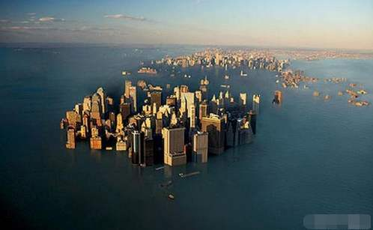
Collect key phrases
1.Suffer from
2.recover from
3.date back to
4.result from
5.hold on to
The earth is getting warmer and warmer.

Slide 14
Collect key phrases
While the human world is suffering from the novel coronavirus outbreak, our planet is showing certain signs of “recovery” from the damage caused by human activity.
to experience physical or mental pain
to get back something lost, especially health, ability, possessions, etc.

Slide 15
Collect key phrases
A team of scientists drilled (钻) a hole into the seafloor in west Antarctica and extracted (提取) material from underground, in which they found traces of roots, spores and pollen – typical products of a rainforest – that dated back 90 million years ago. In other words, Antarctica was very likely a rainforest back when the dinosaurs walked on Earth.
To have lasted since the date of building or origin

Slide 16
Collect key phrases
Now, during the coronavirus lockdown, we’ve seen the changes resulting from less human activity. Hopefully, we’ll hold on to those changes – not for Antarctica or the planet, but for ourselves.
To keep
To be the result of; happen because of

Slide 17
Challenge the sentence
①A team of scientists drilled a hole into the seafloor in west Antarctica and extracted material from underground, ②in which they found traces of roots, spores and pollen – ④typical products of a rainforest – ③that dated back 90 million years ago.

Slide 18
Challenge the sentence
But ⑤ given the fact ⑥ that the South Pole has four months of darkness during winter – even millions of years ago – ①scientists believe ②that the rainforest could only exist ③if the greenhouse gas concentrations were extremely high back then to keep the continent warm ④ when there was little or no sunlight.

Slide 19
Structure of the article
Less human activity has benefited the environment.
Recent discoveries in Antarctica
A record high temperature
Greenhouse climate
A study found traces of a rainforest
Para 3
Para 1
Para 7-8
Para 2-6
Human activity can change the environment.
Para 4
Para 5-6

Slide 20
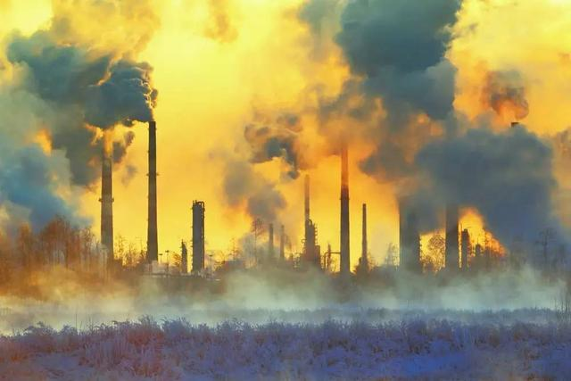
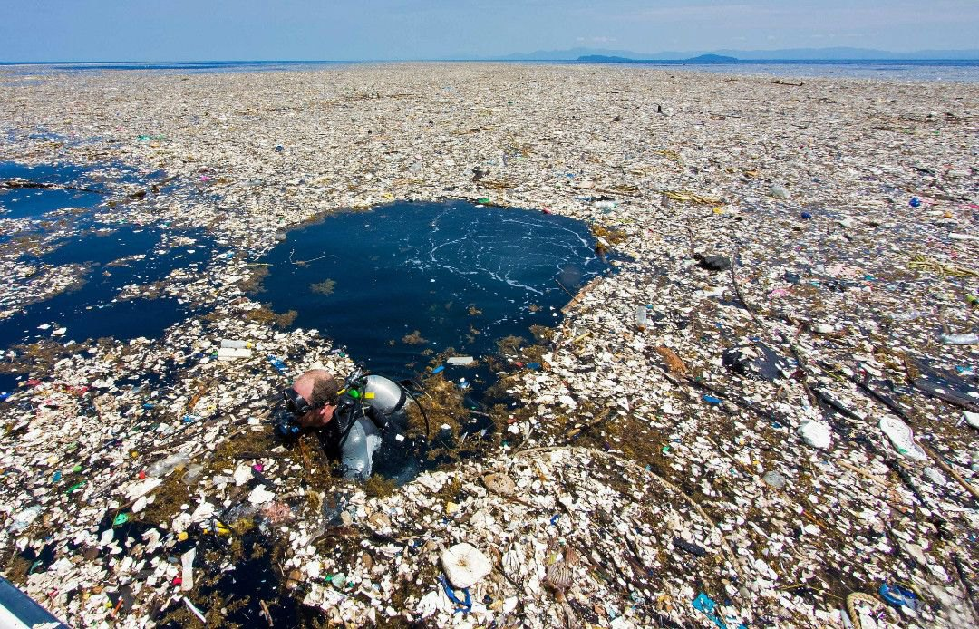
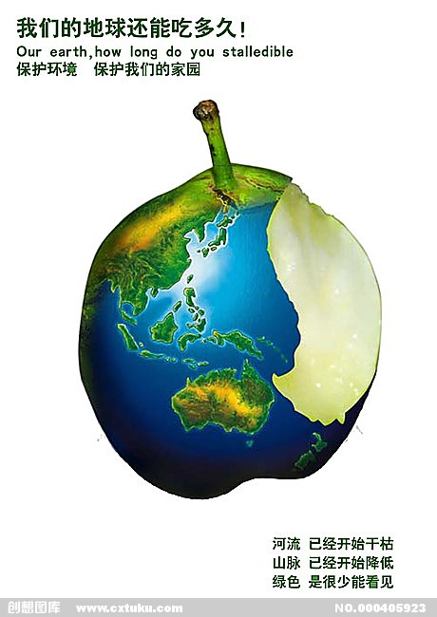
Think deeply
Why did the writer write this article?

Slide 21
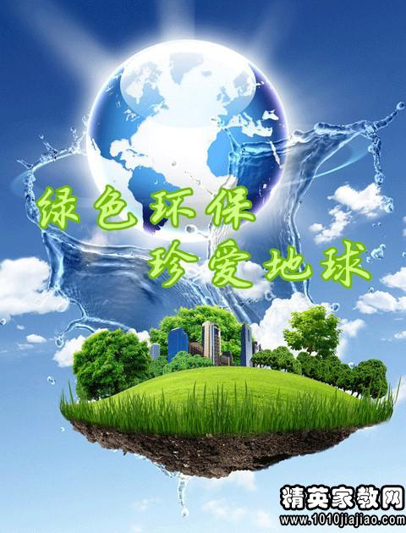
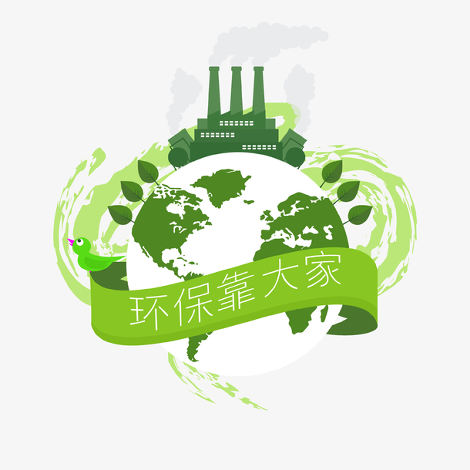
Writing purpose
Why did the writer write this article?

Slide 22
Homework
Please write a short article about what you should do to protect the environment.
____________________________________________________________________________________________________________________________________________________________________________________________________________________________________________________________________________________________________________________________________________________________________________

