Slide 1
21st Century Teens
Newspaper Reading class
By Herrick · Wang Zhijun
Nanchang Foreign Language School

Slide 2
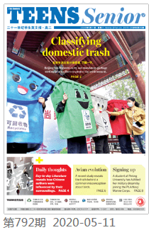

Slide 3
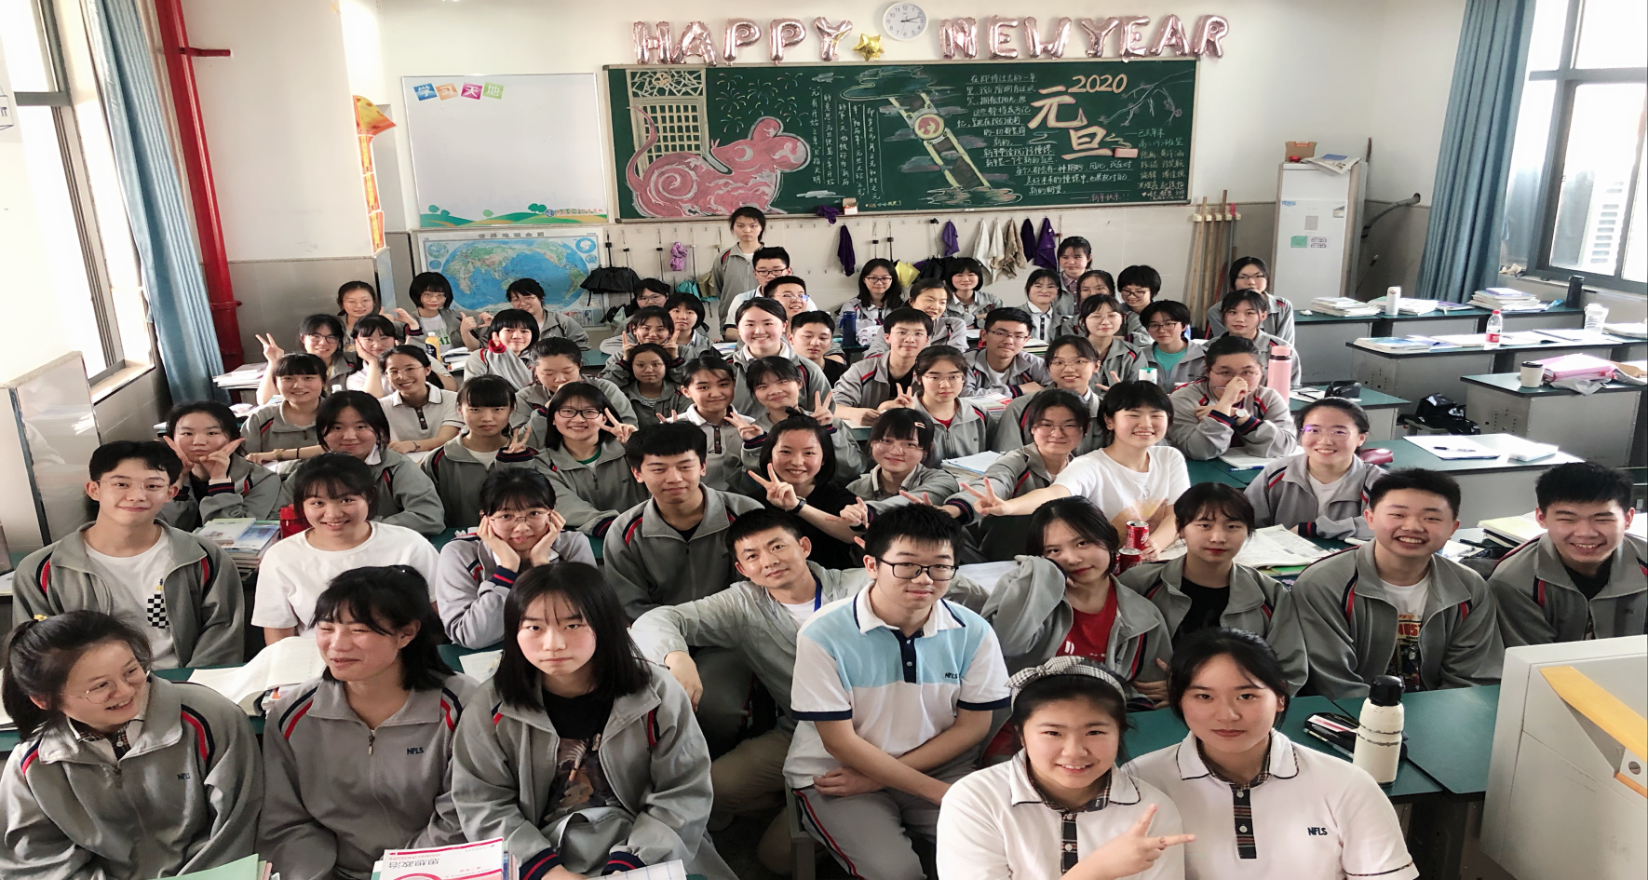
Newspaper extensive reading 1 ISSUE 791
Stay calm in school
Butterfly Hug method;
Restart learning with game thinking
Four Steps solution

Slide 4
Newspaper extensive reading 1 ISSUE 791
Butterfly Hug method
Restart learning with game thinking
First
second
Most importantly
Clarify the mission of the game:
the goal, time limited, current progress
Set up daily tasks, daily feedback; rewards
Improve concentration by practice
Four Steps solution:
Face it . Accept it . Deal with it . Let it go .

Slide 5
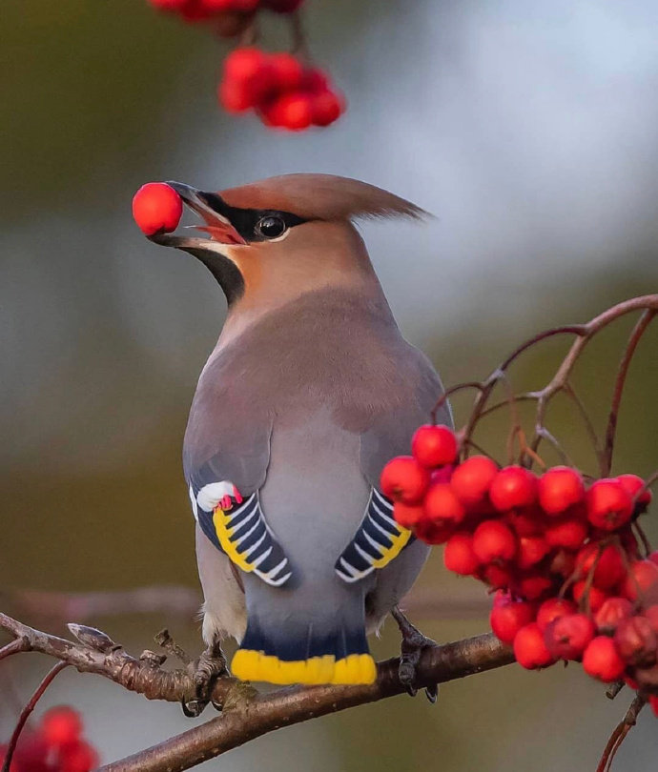
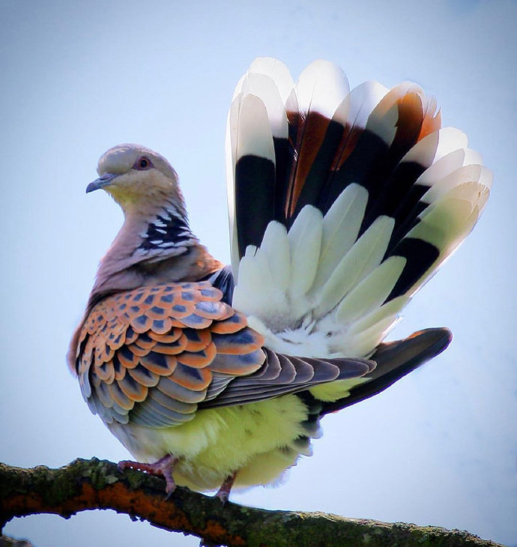
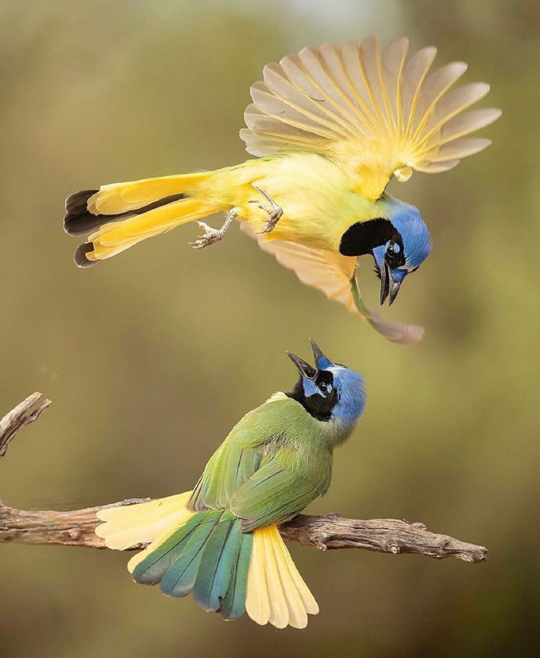
Newspaper extensive reading 2 ISSUE 792
Birds are hugely intelligent

Slide 6
Newspaper extensive reading 2 ISSUE 792
Learn and match words
1. do … justice
2. trigger
3. evolution
4. cognitive capability
treat adequately or fairly
the ability to learn and know information
activate or release or cause something happen
a process of advancing or maturing

Slide 7
Newspaper extensive reading 2 ISSUE 792
1. How did scientists learn the brain sizes of dinosaurs and extinct birds?
A. By referring to a database.
B. By analyzing their body size.
C. By studying their fossil skulls.
D. By examining the brain size of modern birds.
2. What were birds’ brains like after the extinction of the dinosaurs?
A. They were the same size as non-avian dinosaurs.
B. They shrank to adapt to the environment.
C. They kept growing to avoid extinction.
D. They remained as big as they were before.
3. According to Adam Smith, what do we know about birds?
A. Their brain evolution happened very rapidly.
B. Some species evolved to be smarter than others.
C. Crows and parrots have the largest bird brains.
D. Birds have amazing abilities to copy human speech.
C
D
B

Slide 8
Newspaper reading quiz
Issue 791
听歌曲，补全歌词，每空一词。 Let there be love (oasis)
who kicked a hole in the sky so the heavens would cry over me? who stole the _______ from the sun in a world come undone at the seams?
let there be love(x2)
I hope the weather is _______ as you sail up your heavenly stream suspended clear in the sky are the words that we sing in our _______
come on baby blue shake up your tired eyes the world is ________ for you may all your dreaming fill the ______ sky but if it makes you happy keep on clapping just remember I‘ll be by your _______ and if you don’t let go, it‘s gonna pass you by
let there be love(x4)

Slide 9
Newspaper reading quiz
Issue 791
听歌曲，补全歌词，每空一词。 Let there be love (oasis)
who kicked a hole in the sky so the heavens would cry over me? who stole the soul from the sun in a world come undone at the seams?
let there be love(x2)
I hope the weather is calm as you sail up your heavenly stream suspended clear in the sky are the words that we sing in our dreams
come on baby blue shake up your tired eyes the world is waiting for you may all your dreaming fill the empty sky but if it makes you happy keep on clapping just remember I‘ll be by your side and if you don’t let go, it‘s gonna pass you by
let there be love(x4)

Slide 10
Newspaper extensive reading 3 ISSUE 791
Pre-reading
How do you usually chat with your parents and friends? Face to face or on WeChat? Why?
Lost art of conversation

Slide 11
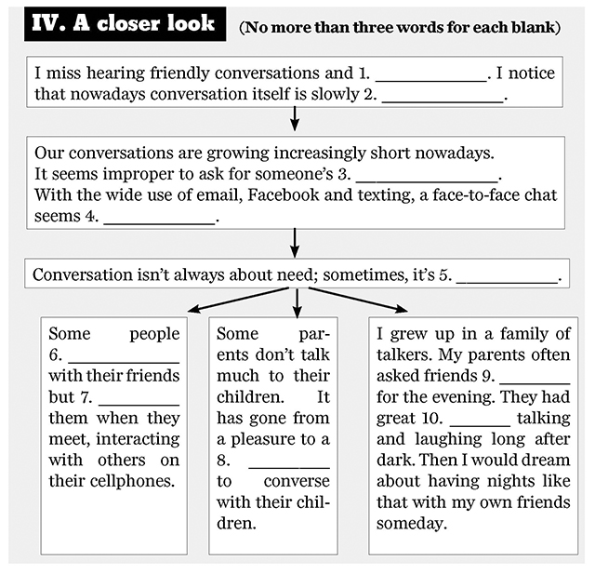
Newspaper extensive reading 3 ISSUE 791
lively chats
disappearing
time and presence
unnecessary
about delight
make plans
over
ignore
fun
duty

Slide 12
Newspaper extensive reading 3 ISSUE 791
Critical thinking
But conversation isn’t always about need; sometimes , it’s about delight. (p5)

Slide 13
Newspaper reading homework
1. Take down the new words and phrases learned today;
2. Issue 791/792:
Intensive reading P2, extensive reading P3/P4.
THANK YOU!

