Slide 2
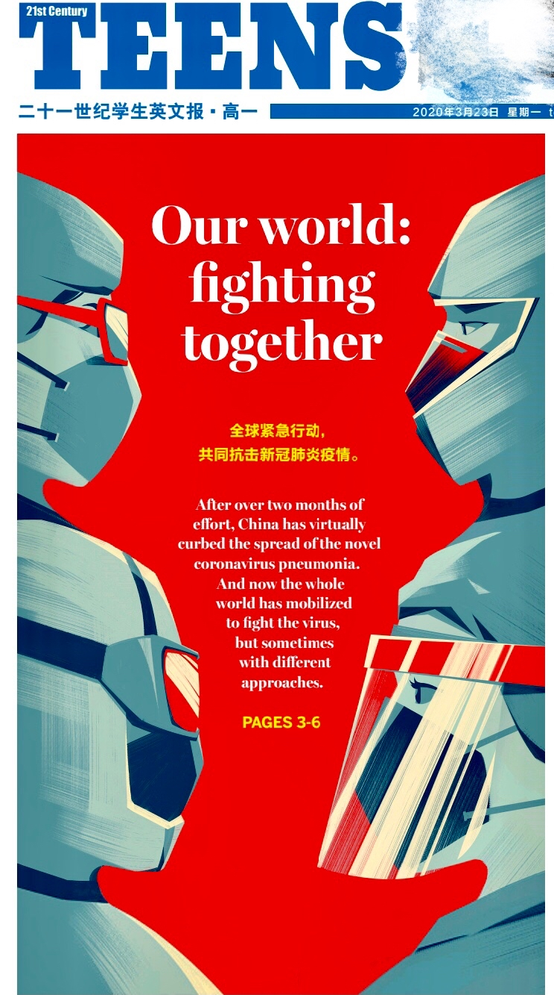
2019-2020学年度第31期总第785期
Our world: fighting together
吕 纯

Slide 3
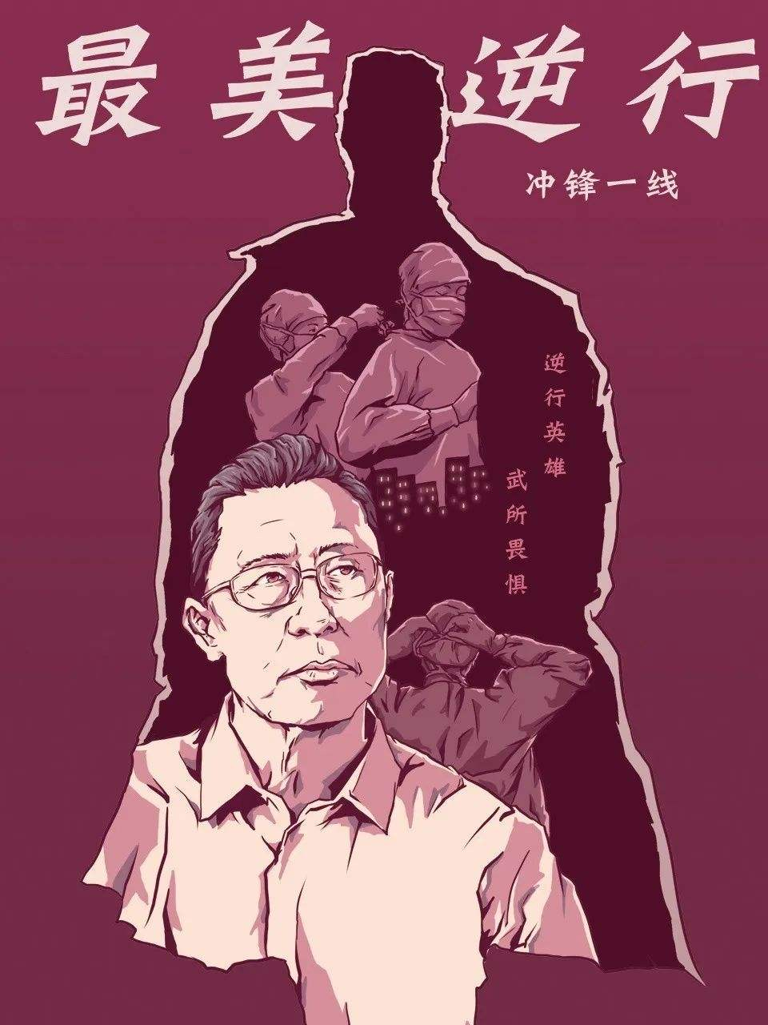
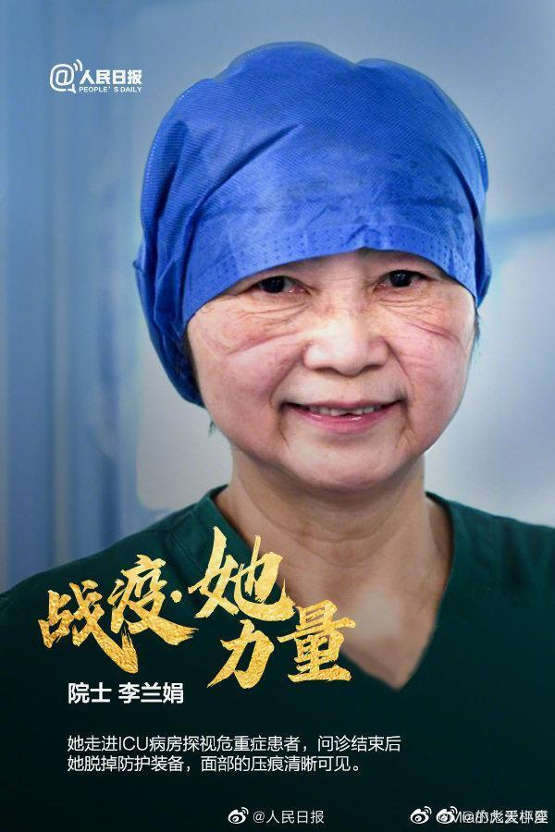
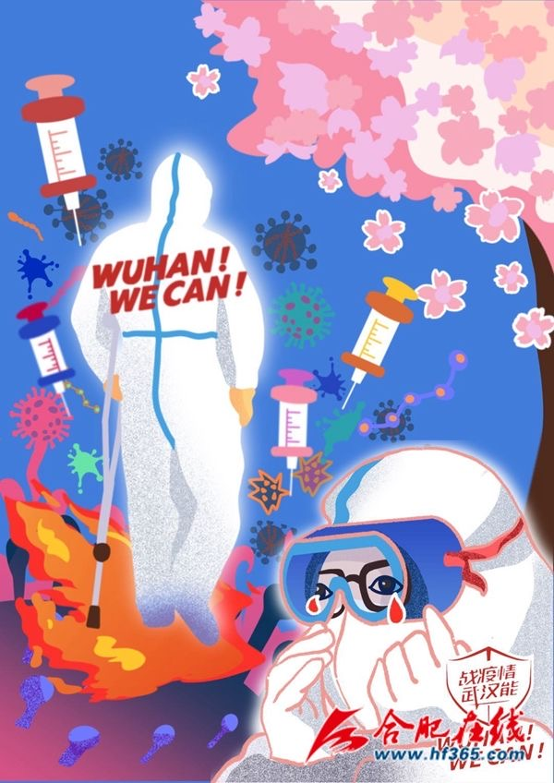
Heroes in Harm's Way

Slide 4
CONTENTS
01
Healthcare around the World ( P6)
General idea and detailed information.
02
Decoding respirator cultures (P4-5)
Vocabulary/Phrases/Language Focus

Slide 5
Control Measures China Has Taken

Slide 6
Healthcare around the World ( P6)
Skim and scan
Get the general idea and detailed information.

Slide 7
Healthcare around the World ( P6)
Choose the best answer:
1. What does the article mainly talk about?
A. Healthcare systems in different countries.
B. Global efforts to fight the novel coronavirus.
C. Different responses to the pandemic worldwide.
D. Challenges facing different countries fighting the pandemic.
2. What does the article tell us about healthcare in Singapore?
A. Public hospitals offer free basic healthcare.
B. Private medical care is not expensive.
C. It works like a housing or education service.
D. Patients need to save money in special accounts beforehand.

Slide 8
Healthcare around the World ( P6)
Choose the best answer:
3. What happens to the poor in a country with universal healthcare?
A. They are treated differently from the rich.
B. They probably can’t afford to see a doctor.
C. They don't need to pay the full medical costs.
D. They need to pay high taxes used for healthcare.
4. What do we learn from Larry Levitt's words?
A. He has confidence in their healthcare system.
B. It will be too difficult for the US if things get worse.
C. They will do better than other developed countries in the fight.
D. All US citizens should be provided with free health insurance.

Slide 9
Healthcare around the World ( P6)
Choose the best answer:
1. What does the article mainly talk about?
A. Healthcare systems in different countries.
B. Global efforts to fight the novel coronavirus.
C. Different responses to the pandemic worldwide.
D. Challenges facing different countries fighting the pandemic.
2. What does the article tell us about healthcare in Singapore?
A. Public hospitals offer free basic healthcare.
B. Private medical care is not expensive.
C. It works like a housing or education service.
D. Patients need to save money in special accounts beforehand.
main idea
key word
(Para3-4)

Slide 10
Healthcare around the World ( P6)
Choose the best answer:
3. What happens to the poor in a country with universal healthcare?
A. They are treated differently from the rich.
B. They probably can’t afford to see a doctor.
C. They don't need to pay the full medical costs.
D. They need to pay high taxes used for healthcare.
4. What do we learn from Larry Levitt's words?
A. He has confidence in their healthcare system.
B. It will be too difficult for the US if things get worse.
C. They will do better than other developed countries in the fight.
D. All US citizens should be provided with free health insurance.
key word
(Para 5)
key word
(Para 8-9)

Slide 11
Healthcare around the World ( P6)
Choose the best answer:
1. What does the article mainly talk about?
A. Healthcare systems in different countries.
B. Global efforts to fight the novel coronavirus.
C. Different responses to the pandemic worldwide.
D. Challenges facing different countries fighting the pandemic.
main idea
para 2
As more areas become affected, you may have noticed that countries are fighting the virus differently. This is because countries have their own unique laws and healthcare systems. Even though they are different, they all share the same goal of keeping people safe and healthy.

Slide 12
Healthcare around the World ( P6)
main idea
1. What does the article mainly talk about?
A. Healthcare systems in different countries.
B. Global efforts to fight the novel coronavirus.
C. Different responses to the pandemic worldwide.
D. Challenges facing different countries fighting the pandemic.
A
para 2
As more areas become affected, you may have noticed that countries are fighting the virus differently. This is because countries have their own unique laws and healthcare systems. Even though they are different, they all share the same goal of keeping people safe and healthy.

Slide 13
Healthcare around the World ( P6)
key word
(Para3-4)
2. What does the article tell us about healthcare in Singapore?
A. Public hospitals offer free basic healthcare.
B. Private medical care is not expensive.
C. It works like a housing or education service.
D. Patients need to save money in special accounts beforehand.
para 3-4
In Southeast Asia, there are many different types of healthcare systems. Take Singapore as an example. In Singapore, the government runs hospitals that provide basic healthcare. It is cheap, but people can pay extra for private rooms and better service.
Medical treatment in Singapore is paid for in a very interesting way. First, workers save money in mandatory (强制的) savings accounts. Then, this money can be used to pay for things like healthcare, housing and education.

Slide 14
Healthcare around the World ( P6)
key word
(Para3-4)
2. What does the article tell us about healthcare in Singapore?
A. Public hospitals offer free basic healthcare.
B. Private medical care is not expensive.
C. It works like a housing or education service.
D. Patients need to save money in special accounts beforehand.
C
para 3-4
In Southeast Asia, there are many different types of healthcare systems. Take Singapore as an example. In Singapore, the government runs hospitals that provide basic healthcare. It is cheap, but people can pay extra for private rooms and better service.
Medical treatment in Singapore is paid for in a very interesting way. First, workers save money in mandatory (强制的) savings accounts. Then, this money can be used to pay for things like healthcare, housing and education.

Slide 15
Healthcare around the World ( P6)
key word (Para 5)
3. What happens to the poor in a country with universal healthcare?
A. They are treated differently from the rich.
B. They probably can’t afford to see a doctor.
C. They don't need to pay the full medical costs.
D. They need to pay high taxes used for healthcare.
para 5
In Europe, many countries have universal (全民的) healthcare. In this type of system, the costs of healthcare are usually covered by taxes. In this way, the rich help pay for the poor and younger people help pay for the elderly. Universal healthcare helps reduce medical costs for anyone who may need to see a doctor or get treatment.

Slide 16
Healthcare around the World ( P6)
key word (Para 5)
3. What happens to the poor in a country with universal healthcare?
A. They are treated differently from the rich.
B. They probably can’t afford to see a doctor.
C. They don't need to pay the full medical costs.
D. They need to pay high taxes used for healthcare.
C
para 5
In Europe, many countries have universal (全民的) healthcare. In this type of system, the costs of healthcare are usually covered by taxes. In this way, the rich help pay for the poor and younger people help pay for the elderly. Universal healthcare helps reduce medical costs for anyone who may need to see a doctor or get treatment.

Slide 17
Healthcare around the World ( P6)
key word (Para 8-9)
4. What do we learn from Larry Levitt's words?
A. He has confidence in their healthcare system.
B. It will be too difficult for the US if things get worse.
C. They will do better than other developed countries in the fight.
D. All US citizens should be provided with free health insurance.
para 8-9
“Addressing (对付) the coronavirus with tens of millions of people without health insurance … will be a uniquely American challenge among developed countries,” Larry Levitt, the executive vice president for health policy at Kaiser Family Foundation, wrote on Twitter.
Healthcare systems are designed to help people who are sick. But, if too many people get sick at once, it can be difficult for countries with even the best healthcare systems to handle.

Slide 18
Healthcare around the World ( P6)
key word (Para 8-9)
4. What do we learn from Larry Levitt's words?
A. He has confidence in their healthcare system.
B. It will be too difficult for the US if things get worse.
C. They will do better than other developed countries in the fight.
D. All US citizens should be provided with free health insurance.
B
para 8-9
“Addressing (对付) the coronavirus with tens of millions of people without health insurance … will be a uniquely American challenge among developed countries,” Larry Levitt, the executive vice president for health policy at Kaiser Family Foundation, wrote on Twitter.
Healthcare systems are designed to help people who are sick. But, if too many people get sick at once, it can be difficult for countries with even the best healthcare systems to handle.

Slide 19
Decoding respirator cultures (P4-5)
Vocabulary
Phrases
Language Focus

Slide 20
Background information
2. According to the WHO, a pandemic is "an epidemic occurring worldwide, or over a very wide area, crossing international boundaries and usually affecting a large number of people."
什么是大流行病（pandemic）
1. "WHO has been assessing this outbreak around the clock and we are deeply concerned both by the alarming levels of spread and severity, and by the alarming levels of inaction," WHO Director-General Tedros Adhanom Ghebreyesus said. "We have therefore made the assessment that COVID-19 can be characterized as a pandemic."
3. Tedros said that pandemic is not a word to use lightly or carelessly. "It is a word that, if misused, can cause unreasonable fear, or unjustified acceptance that the fight is over, leading to unnecessary suffering and death," he said.

Slide 21
vocabulary--- derivative
effective a. --- _________________ n.
essential a. --- _________________ adv.
partial a. --- _________________ adv.
various a. --- _________________ n.
comfort n.--- _________________ a.
group-oriented values 以集体为导向的价值
______________________以素质为中心的教育

Slide 22
vocabulary--- derivative
effective a. --- _________________ n.
essential a. --- _________________ adv.
partial a. --- _________________ adv.
various a. --- _________________ n.
comfort n.--- _________________ a.
group-oriented values 以集体为导向的价值
_______________________________以素质为中心的教育
effectiveness
essentially
partially
variety
comfortable
quality-oriented education

Slide 23
Phrases
speed up
be engrained in
a variety of
take ... into consideration

Slide 24
Phrases
speed up 加速
原文：As the global pandemic speeds up ...
造句： 我找到了一个加速这个过程的方法。

Slide 25
Phrases
speed up 加速
原文：As the global pandemic speeds up ...
造句： 我找到了一个加速这个过程的方法。
I have found a way to speed up this process.

Slide 26
Phrases
be engrained in ...根深蒂固
原文：mask-wearing is engrained in their
cultures.
造句： 音乐深深扎根于印第安人文化中，人们把它视作自我表达的一种形式。

Slide 27
Phrases
be engrained in ...根深蒂固
原文：mask-wearing is engrained in their
cultures.
造句： 音乐深深扎根于印第安人文化中，人们把它视作自我表达的一种形式。
Music is deeply engrained in Indian culture and people see it as a form of self-expression.

Slide 28
Phrases
a variety of 各种各样的
原文：East wear masks not just to protect themselves from illness but also for a variety of other reasons.
造句： 有种类繁多的图案可供选择。

Slide 29
Phrases
a variety of 各种各样的
原文：East wear masks not just to protect themselves from illness but also for a variety of other reasons.
造句： 有种类繁多的图案可供选择。
There is a variety of patterns to choose from.

Slide 30
Phrases
take ... into consideration 把...考虑进来
原文：That’s because human beings are social creatures who take into consideration what other members of society think of us.
造句： 你要把天气情况考虑进来。

Slide 31
Phrases
take ... into consideration 把...考虑进来
原文：That’s because human beings are social creatures who take into consideration what other members of society think of us.
造句： 你要把天气情况考虑进来。
You should take the weather into consideration.

Slide 32
Language Focus
1. Most people from the East believe that (wear) a mask is essential to control the spread of the novel coronavirus pneumonia (NCP).
2.They can give people the comfort of (protect).
3.Young people in Japan, for example, wear masks as a fashion statement, (express) their personal style through unique designs and patterns.
4. With one’s face partially (cover), one becomes part of a giant collectivist (集体主义的) whole.
5. As a citizen, it is one’s duty (prevent) the spread of illness by following proper hygienic procedures, such as washing one’s hands and limiting one’s contact with others.

Slide 33
Language Focus
1. Most people from the East believe that (wear) a mask is essential to control the spread of the novel coronavirus pneumonia (NCP).
2.They can give people the comfort of (protect).
3.Young people in Japan, for example, wear masks as a fashion statement, (express) their personal style through unique designs and patterns.
4. With one’s face partially (cover), one becomes part of a giant collectivist (集体主义的) whole.
5. As a citizen, it is one’s duty (prevent) the spread of illness by following proper hygienic procedures, such as washing one’s hands and limiting one’s contact with others.
wearing
being protected
expressing
covered
to prevent

Slide 34
Language Focus
--- non-finite verbs 非谓语动词
1. Most people from the East believe that (wear) a mask is essential to control the spread of the novel coronavirus pneumonia (NCP).
2.They can give people the comfort of (protect).
3.Young people in Japan, for example, wear masks as a fashion statement, (express) their personal style through unique designs and patterns.
4. With one’s face partially (cover), one becomes part of a giant collectivist (集体主义的) whole.
5. As a citizen, it is one’s duty (prevent) the spread of illness by following proper hygienic procedures, such as washing one’s hands and limiting one’s contact with others.
wearing
being protected
expressing
covered
to prevent

Slide 35
Language Focus
--- non-finite verbs 非谓语动词
1. Most people from the East believe that _________ (wear) a mask is essential to control the spread of the novel coronavirus pneumonia (NCP).
V-ing 做主语
wearing

Slide 36
Language Focus
--- non-finite verbs 非谓语动词
2.They can give people the comfort of
____________________ (protect).
V-ing 做介词宾语， 被动语态
being protected

Slide 37
Language Focus
--- non-finite verbs 非谓语动词
3.Young people in Japan, for example, wear masks as a fashion statement, ______________ (express) their personal style through unique designs and patterns.
V-ing 做状语。
expressing

Slide 38
Language Focus
--- non-finite verbs 非谓语动词
4. With one’s face partially __________ (cover), one becomes part of a giant collectivist whole.
with 的复合结构 with +O. +OC.
covered

Slide 39
Language Focus
--- non-finite verbs 非谓语动词
4. With one’s face partially __________ (cover), one becomes part of a giant collectivist whole.
with 的复合结构。
He hurried to his office, with his breakfast ___________ (untouch).
He was deep in thought, with his hands ____(hold) a cup of coffee for quite a long time.
covered

Slide 40
Language Focus
--- non-finite verbs 非谓语动词
4. With one’s face partially __________ (cover), one becomes part of a giant collectivist whole.
with 的复合结构。
He hurried to his office, with his breakfast ___________ (untouch).
He was deep in thought, with his hands ________(hold) a cup of coffee for quite a long time.
covered
untouched
holding

Slide 41
Language Focus
--- non-finite verbs 非谓语动词
5. As a citizen, it is one’s duty ___________ (prevent) the spread of illness by following proper hygienic procedures, such as washing one’s hands and limiting one’s contact with others.
it 做形式主语，不定式做真正的主语。
to prevent

Slide 42
Words related to COVID-19

Slide 43
没有一个冬天不可逾越，没有一个春天不会到来。
Winter will eventually pass, and spring is sure to come.

Slide 44
Thank you!

